Slide 1
Veeam Availability Suite v10: A Deeper Dive of What’s New
PBO3309BUS
Danny Allan - VP, Cloud & Alliance Strategy
Rick Vanover – Director, Technical Product Marketing
#VMworld #PBO3309BUS

Slide 2


Any Infrastructure
On-Premises
SaaS
Any Service
File
App
VM
Physical
Always-On Availability
VCSP
MSP
Cloud
Notes:
Danny do slide exclusviely

Slide 3
82%
of enterprises have an Availability Gap
$22M
cost of Availability and protection gaps
66%
of Enterprise Digital transformation efforts slowed by Availability gaps
Notes:
Danny And we are here to help

Slide 4



Non-Stop
Business Continuity
Digital Transformation
Agility
Analytics and Visibility
2.5 x less Failures
3 x more Speed
91% SLA
Monitor, analyze and act with confidence
Your cloud, your way
Notes:
Rick: Veeam enables any business to deliver the Digital Life experience users expect with Veeam Availability Suite for the ‘Always on Cloud’. The Suite provides:
Non-Stop Business Continuity
Digital Transformation Agility
Analytics and Visibility
As enterprises move to the Cloud, Veeam ensures Availability of services, applications and data in Multi-Cloud and Hybrid-Cloud environments.

Slide 5
Any Infrastructure
On-Premises
SaaS
Veeam Availability Platform
Veeam Agents for Windows & Linux
Veeam Availability Orchestrator
Veeam Backup for Office 365
NEW Veeam Availability Suite v10
Veeam Backup & Replication | Veeam ONE
VCSP
MSP
Cloud
Notes:
Danny

Slide 6

Built-in Management
for Veeam Agents
NAS Backup
Support
NEW Veeam v10
10
10
out
of
Universal Storage Integration API
Tier-1 Applications and mission-critical services with NEW Veeam CDP
for Availability
Native Object Storage Support
Notes:
Danny: NEW Veeam Availability Suite v10 drives business continuity and agility to new levels:
- Keep your business running with recovery SLAs of seconds with the ‘Always On Cloud’ Availability Platform, including physical servers and Network Attached Storage (NAS)
- Increase ease of use via Cross-Cloud Data Management of any workload: virtual, physical or cloud on any infrastructure: private, public, managed or SaaS in Multi-Cloud and Hybrid Cloud
- Decrease costs while freeing up expensive primary backup storage through object storage support and policy-driven data management

Slide 7
NEW Built-In
Agent
Management

Slide 8
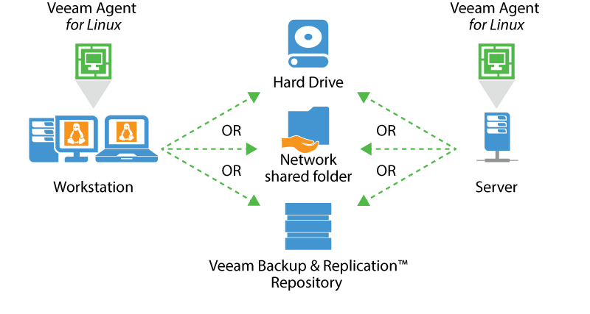
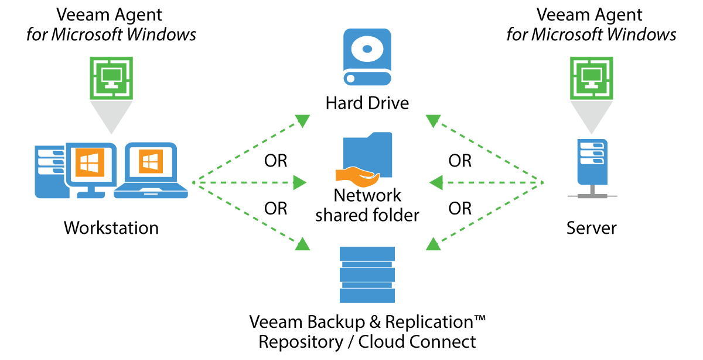
Built-in Management for Agents
Reduce management complexity and improve usability through direct integration of agents into Veeam Backup & Replication (Veeam Agent for Linux and Microsoft Windows).
Notes:
Danny

Slide 9



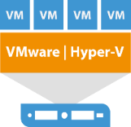


Agent integration: Protection groups
(Static)
Company infrastructure
Domain Hierarchy
Security Groups
Organization Units
Workstation
Laptop
Workstation
Individual PCs
Active
Directory
.CSV list
VBR server
Virtual host
Virtual host
Server
Server
Notes:
Rick: VBR 9.5 Update 3: Updated UI brings the concept of “inventory”, showing both virtual environments (vSphere, Hyper-V) and protected computers (physical, cloud)
Discovery types: individual computer, AD objects (with exclusion filters like exclude VMs), CSV file
Automatically discovered group (pre-built): any manually configured agent, pointed to VBR repository goes here
Static is like add it and it stays (but computer or DNS name)
static is like a once add and it stays. like computer or DNS[1:10] dynamic is adding like a container[1:10] and its refreshed based on the schedule[1:10] so any time smth new gets added its automatically protect[1:10] like adding a vm to a job vs a folder[1:11] once versus recurring
Updated VBR UI brings the concept of “inventory” - showing both virtual environments (vSphere, Hyper-V) and protected computers (physical, cloud) at the same place – inventory tab
Protection group types:
Single Hosts - IP / DNS Name
Active Directory Items - Domain, OU, Groups, Computers
.CSV file - list of computers (Linux shop)
Discovery process: VBR server discovers company infrastructure using the specified way and combines desired physical workloads into the same protection group.

Slide 10
Agent integration: Protection groups
(Dynamic)
Company infrastructure
Domain Hierarchy
Security Groups
Organization Units
Workstation
Workstation
Laptop
Laptop
Workstation
Individual PCs
Active
Directory
.CSV list
VBR server
Virtual host
Virtual host
Server
Server
Server
Notes:
Rick: VBR 9.5 Update 3: Updated UI brings the concept of “inventory”, showing both virtual environments (vSphere, Hyper-V) and protected computers (physical, cloud)
Discovery types: individual computer, AD objects (with exclusion filters like exclude VMs), CSV file
Automatically discovered group (pre-built): any manually configured agent, pointed to VBR repository goes here
Dynamic will add a container
static is like a once add and it stays. like computer or DNS[1:10] dynamic is adding like a container[1:10] and its refreshed based on the schedule[1:10] so any time smth new gets added its automatically protect[1:10] like adding a vm to a job vs a folder[1:11] once versus recurring

Slide 11

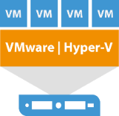


Agent integration: Managed mode
Main Datacenter
Mixed Infrastructure
VBR server
Veeam Agent
data mover
Veeam Agent
data mover
Workstation/
Desktop
Server
Virtual host
Backup
repository
Notes:
Danny - VBR targets physical machines and installs on them only a data mover. There’s no Agent UI, nor Agent DB
With this mode users get experience similar to what they already acquainted with. VBR is a central backup hub, it schedules and executes backup operations.
Managed mode is recommended for workloads, working 24/7 at the same data center.

Slide 12



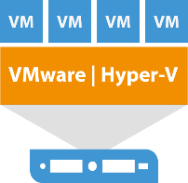

Agent integration: Standalone mode
Main Datacenter
Veeam Agent
VBR server
Agent
Service
Agent
Tray
Agent
Database
Traveling
sales
ROBO
Home
users
Backup
repository
Notes:
Danny - VBR targets physical machines and installs on them a full Agent component. Local users can operate with Agent UI
Agents operate independently. Whenever, the device reaches corporate network, VBR updates local Agents with new settings/configuration and backups are transferred to the main backup repository.

Slide 13
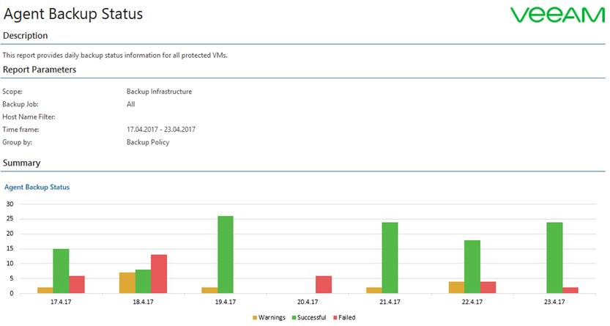
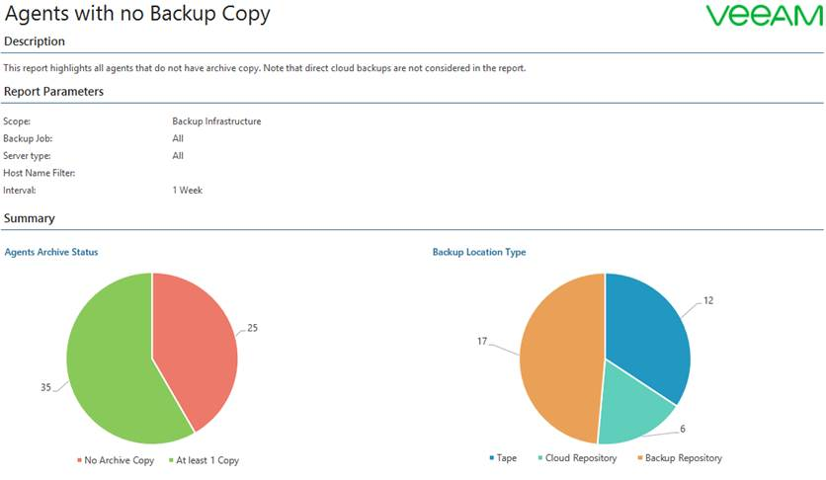
Veeam ONE: Built-in Agent Reporting
Veeam ONE includes reports to assist with Agent Management and help identify:
Protected agents
Agent backup status
Identify agents with no backup copy
Notes:
Rick: Veeam Availability Suite v10 delivers reduced management complexity and improved usability through the direct integration of agent management into the Veeam Backup & Replication console. Direct integration with Veeam Agent for Linux and Veeam Agent for Windows will allow users to manage backup and replication functionality for both virtual and physical infrastructures through a single console. Built-in full agent management provides users
The ability to deliver centralized deployment and management
A single pane of glass to see all backups and restores in one console
Microsoft failover cluster support

Slide 14
DEMO
Notes:
Rick:

Slide 15


NEW Veeam v10
10
10
Available now
out
of
Coming in v10
for Availability
Universal Storage Integration API
Notes:
Danny Extend Availability and improve recovery time and point objectives (RTPO™) through primary storage integrations with leading storage providers through a universal plug-in framework enabling select partners to build integrations with Veeam Backup & Replication. New integrated storage solutions based on the API include IBM Spectrum Virtualize (IBM SAN Volume Controller (SVC) and the IBM Storwize family), Lenovo Storage V Series and INFINIDAT.

Slide 16
Universal Storage API
Take backups at any time!
Direct integration with the world’s leading storage providers broadens Veeam’s list of integrated partnerships.
Improves performance for existing joint users and future customers.
Users can experience 50x faster backups, improved RTOs and RPOs, and easy to use, wizard-driven integrations.
Notes:
Danny Not really universal.
QA in all situations done by Veeam.

Slide 17
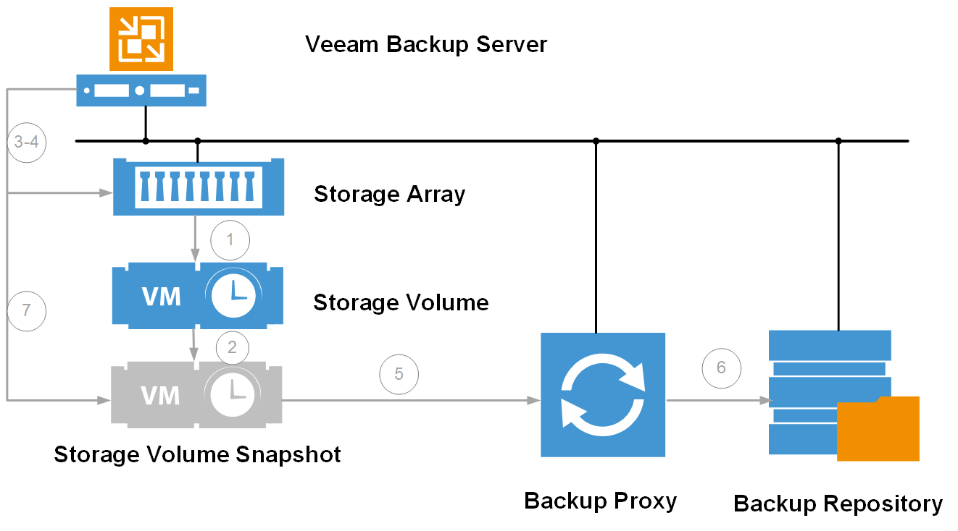
Notes:
Rick

Slide 18
Features by Storage Integration
Model (Bold is Generally Available) | Integration Developer | BfSS | BfSS with Snapshot Retention | VESS | On Demand Labs | Snapshot-Only Jobs | Snapshot Replication
HPE StoreVirtual/VSA/(HC380) | Veeam | X |  | X | X
HPE 3PAR | Veeam | X |  | X | X
HPE Nimble | Veeam | X | X | X | X | X | X
NetApp ONTAP | Veeam | X | X | X | X | X | X
DellEMC VNX/VNXe/Unity | Veeam | X |  | X | X
Cisco HyperFlex (VM Snapshots) | Veeam | X
IBM/Lenovo Spectrum Virtualize (Storwize/SVC/V Series/VersaStack) | Veeam (Storage API) | X | X | X | X | X
Infinidat | Infinidat (Storage API) | X | X | X | X | X
New Vendors (Pure Storage) | Vendor (Storage API) | X | X | X | X | X
Notes:
Rick

Slide 19
DEMO
Notes:
Rick:

Slide 20
NEW Veeam v10
10
10
out
of
for Availability
Archive Tier & Native Object Storage Support
Notes:
danny

Slide 21






Archive Tier of Scale-Out Repository
Cloud Object Storage
.vbk
.vib
DAS
AWS S3/Swift Compatible
Amazon S3
Amazon
Glacier
Microsoft Azure
Blob Storage
Move/
Copy
.vbk
.vib
+
Cheap Secondary Storage
NAS
Policy Driven
Scale-out
Backup Repository
.vbk
.vib
Deduplication Appliance
Deduplication
Appliance
Physical
Storage
Tape
Notes:
Danny
Archival tier is a storage agnostic (any Target, any Media) and longer-term purposed archive of backup files
Key functionality:
Oldest backups will be moved to the archive tier automatically
Compliance is maintained according with a retention policy
Policy based driven Archive: “move backup files older than X days” or “copy backup files when they are created”, etc

Slide 22
DEMO
Notes:
rick

Slide 23
NEW Veeam v10
10
10
out
of
for Availability
NAS Backup Support
Notes:
Danny Maintain Availability through the expansion of Veeam’s protected data footprint with file-level backup support for Network Attached Storage (NAS) for SMB and NFS shares. Support includes scalable SMB/NFS backups, flexible data protection through short and long-term retention policies and out-of-place restore to easily restore SMB/NFS files to any target.

Slide 24

NAS Backup support
Maintain Availability through file-level backup support for Network Attached Storage (NAS) including:
Scalable SMB/NFS backups
Flexible data protection through short and long-term retention policies
Out-of-place restore to easily restore SMB/NFS files to any target
New logic of file revisions & long term retention
Key points on restore:
Can restore to a completely dissimilar NAS system
Can restore entire NAS back to last backup (ransomware)
Can restore individual files as well
Notes:
Rick

Slide 25



NAS Backup
NFS/SMB share
VBR server
NAS
File Backup
Proxy
Backup
repository
Archive
repository
(object storage
recommended)
Notes:
Rick | Proximity logic
Notes:
Supporting NAS, SMB, NFS (we already have a solid NFS client), local folder backups
Cache repository contains metadata of last known state of the share
SMB scale - adding more file-proxy roles (yet another role), multiple SMB clients pulling the data
We purposely create fragmentation to fight worse fragmentation (put files into containers 64k, 32k, etc to have a control over chunks and fragmentation)
noSQL DB of our own development, sort of transaction log, keeping records of metadata
CBT happens on a file level, not a block level,

Slide 26
DEMO
Notes:
Rick

Slide 27
NEW Veeam v10
10
10
out
of
for Availability
Veeam CDP (Continuous Data Protection)
Notes:
Danny: Preserve critical data during a disaster and ensure the Availability of tier-1 VMs with VMware-certified continuous data protection to reduce RPOs from minutes to seconds, as well as leverage VMware’s VAIO framework to reliably intercept and redirect VM I/O to the replica without a need to create standard VM snapshots.

Slide 28

Veeam CDP (Continuous Data Protection)
Preserve critical data during a disaster and ensure the Availability of tier-1 VMs with VMware-certified CDP to:
  Reduce recovery point objective (RPOs) to 15 seconds
  Leverage VMware’s vSphere API for I/O Filtering to reliably redirect VM I/O to the replica without creating standard VM snapshots
  Apply customizable schedule to align with desired RPO
  Get assurance through VMware certification
Notes:
Danny: Learn more about generic CDP - https://en.wikipedia.org/wiki/Continuous_data_protection
Learn more about VAIO - https://code.vmware.com/programs/vsphere-apis-for-io-filtering

Slide 29
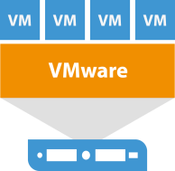

Veeam CDP (Continuous Data Protection)
CDP Policy
VBR server
vCenter
VAIO API
CDP Proxy
with cache
Target
CDP Proxy
Source VMware
cluster
Target VMware
cluster
Notes:
Rick: Veeam CDP is designed differently, comparing to existing Replication Job. It bring a new JOB type – “CDP policy” (technically it’s not a Job, it goes with very different approach).
To configure: install CDP filter to vCenter (cluster) when adding vCenter to VBR configuration (filter maintains I/O journal)
CDP proxy with cache: either VM or physical computer with cache storage to accommodate replication traffic and prevent lags
Recommended for SMB companies: running CDP proxy on the same host, so CDP traffic goes to it through VMbus.
Recommended for Enterprise: using a dedicated NIC and offload traffic and loads from production to another box.
Long-term retention is achieved by using delta disks (255 max) instead of 28-32 VM snapshots
Applicable for: vSphere Standard edition and above, (VAIO using SPBM, no Essentials)

Slide 30
DEMO
Notes:
Rick

Slide 31
…but there is more

Slide 32
NEW Veeam v10
Support for Oracle
RMAN/RAC
Notes:
Danny and then Rick.

Slide 33
NEW Veeam v10
Extended
Role-Based-Access
Notes:
Danny and then Rick.

Slide 34
NEW Veeam v10
DRaaS Enhancements
(for service providers)
Notes:
Danny and then Rick. Service providers can help tenants minimize costs and reduce recovery times during a disaster with new Disaster Recovery as a Service (DRaaS) enhancements including vCloud Director integration for Veeam Cloud Connect Replication and Tape as a Service (TaaS) for Veeam Cloud Connect Backups.

Slide 35
Any Infrastructure
On-Premises
SaaS
Veeam Availability Platform
Veeam Agents for Windows & Linux
Veeam Availability Orchestrator
Veeam Backup for Office 365
NEW Veeam Availability Suite v10
Veeam Backup & Replication | Veeam ONE
VCSP
MSP
Cloud
Notes:
Danny – then rick, mention Vmware Cloud on AWS; Drive to our booth.

Slide 36
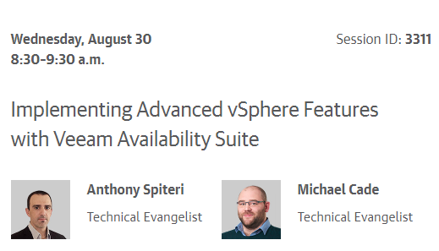
More Veeam @ VMworld
Booth #417
Party Tuesday
8PM Hakkasan
Need badge & ID!
Veeam.com
Notes:
Rick: Mention paper on encryption.

Slide 37

Q&A
Thank you - Enjoy VMworld
Slides: http://vee.am/vmworldprezo

